Slide 1
Genetic Counseling

Slide 2
What is Genetic Counseling?
Communication process that deals with the human problems associated with the occurrence of a genetic disorder in a family.
address individual concerns relating to development / transmission of hereditary disorder;
strong communicative and supportive element so that those who seek information are able to reach their own fully informed decisions without undue pressure or stress.

Slide 3
Contd…
This process involves an attempt by one or more appropriately trained person to help the individual and family.
It is the process of :
Evaluating family history and medical records
Ordering genetic test
Evaluating the results of this investigation
Helping parents understand and reach decision about what to do next

Slide 4
What Information should be provided?
medical diagnosis and its implications in terms of prognosis and possible treatment
mode of inheritance of disorder and the risk of developing and/or transmitting it
choices or options available for dealing with the risks

Slide 5
Conditions requiring genetic counseling
Abnormal AFP on screening
Abnormal result of amniocentesis
Inherited disease or birth defect in either parent or a close relative
Either parent already have children with birth defects or genetic disorder.
>2 miscarriage or infant dead of unknown cause
Primi after 35 years (1:350 after 35 years, 1:110 at 40, 1:30 at 45)
Certain ethnic group, sickle cell anaemia in Tharu.

Slide 6
Genetic Counseling
Approach is non-directive
Timing
Prenatal counseling
Counseling of a family when inherited disorder has occurred

Slide 7
Steps in Genetic Counseling
Diagnosis - based on history, examination and investigations
Risk assessment
Communication
Discussion of Options
Long-term contact and support

Slide 8
Establishing the Diagnosis
most crucial step in any genetic counseling
if incorrect - totally misleading information could be given with tragic consequences
reaching diagnosis involves three fundamental steps
taking a history
examination
undertaking appropriate investigations

Slide 9
Establishing the Diagnosis
Information about client’s family is obtained by skilled genetics nurse or counselor
pre-clinic telephone or home visit is helpful
clinic visit - full examination
appropriate tests - chromosomes, molecular studies, referral to specialists (neurology, ophthalmology).

Slide 10
Calculating and Presenting the Risk
straightforward counseling situations - little more than knowledge about Mendelian inheritance is needed
Problems:
delayed age of onset
reduced penetrance-Penetrance refers to the proportion of people with a particular genetic change (such as a mutation in a specific gene) who exhibit signs and symptoms of a genetic disorder. If some people with the mutation do not develop features of the disorder, the condition is said to have reduced (or incomplete) penetrance. Reduced penetrance often occurs with familial cancer syndromes.

Slide 11
Mendelian Inheritance
Mendelian inheritance refers to an inheritance pattern that follows the laws of segregation and independent assortment in which a gene inherited from either parent segregates into gametes at an equal frequency.
Three major patterns of Mendelian inheritance for disease traits are described: autosomal dominant, autosomal recessive, and X-linked.
Mendelian inheritance patterns refer to observable traits, not to genes.
Some alleles at a specific locus may encode a trait that segregates in a dominant manner, whereas another allele may encode the same or a similar trait, but instead it segregates in a recessive manner.

Slide 12
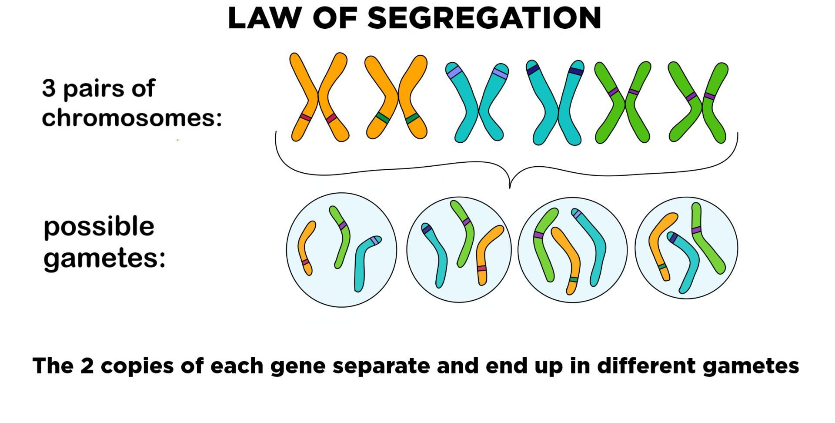

Slide 13
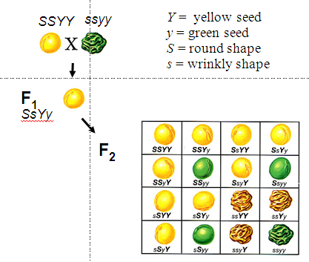

Slide 14
Presenting the Risk
does not simply involve conveying stark risk figures in isolation
parents must be given as much background as possible
as rule of thumb: recurrence risks should be quantified, qualified and placed in context

Slide 15
Quantification
Most prospective parents will have some concept of risks
Experience demonstrates that some common misinterpretations occur
a risk of 1 in 4 may be remembered as 4 to 1, 1 in 40, or even 14% !!!
the risk only applies to every fourth child !!

Slide 16
Qualification - Nature of a Risk
factor which influences parents when deciding whether to have another child is nature of the long-term burden associated with a risk rather than precise numerical value
“high-risk” of 1 in 2 for a trivial problem (polydactaly) will not deter many families while a “low risk” of 1 in 25 for a disabling condition (NTD) can have a significant deterrent effect

Slide 17
Discussing the Options
provide clients with all information needed to arrive at their own informed decision
details of all the choices open to them - include a complete discussion of reproductive options
alternative approaches to conception – AID-Artificial insemination by Donor, donor ova
review of techniques, limitations and risks associated with methods available for prenatal diagnosis

Slide 18
Communication and Support
Communication - two way process
Counselor provides information
Receptive to fears and aspirations: expressed or unexpressed by consultand
Information - present in clear, sympathetic and appropriate manner

Slide 19
Communication and Support
Individual or couple will be extremely upset when first made aware of a genetic disorder
complex psychological and emotional factors can influence counseling dialogue
setting - agreeable, private and quiet, with ample time for discussion and questions

Slide 20
Counseling
Session can be so intense and intimidating that amount and accuracy of information retained is very disappointing
Letter summarizing the topics discussed at counseling session is often sent to family
Follow-up home visit or clinic appointment to clarify any confusing issues
Notes:
Intimidating-frightening

Slide 21
Directive or Non-Directive
Universal agreement - non-coercive with no attempt to direct consultand along a course of action
Non-judgmental - even if decision reached seems ill-advised
Unwise to answer “What would you do if placed in my position?” rather consideration should be given to consequences of each possible course of action
remember - counsultand has to live with consequences!!!

Slide 22
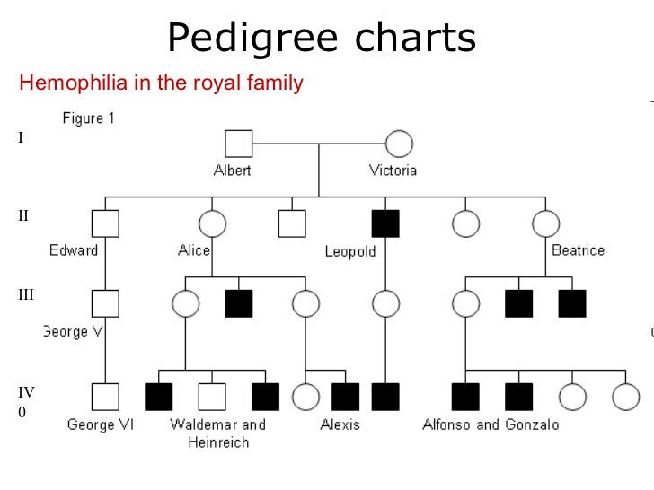

Slide 23
Special Problems in Genetic Counseling
Consanguinity and Incest
Adoption and genetic disorders
Disputed Paternity

Slide 24
Consanguinity and Incest
Consanguineous Marriage is between blood relatives who have at least one common ancestor no more remote than great-great grand parent
Incest - union between first degree relatives (brother-sister, parent-child)

Slide 25
Proportion of Genes Shared
Genetics relationship Proportion shared Risk of abnormality of partners genes in offspring First Degree 1/2 50% parent-child brother-sister Second Degree 1/4 5-10% uncle-niece aunt-nephew
double first cousins 1/8 3-5%

Slide 26
Frequencies of three main types of abnormalities in the children of incestuous relationships
Mental Retardation 25%
Autosomal recessive disorder 10-15%
Congenital malformations 10%

Slide 27
Paternity Testing
genetic fingerprinting using minisatellite repeat sequence probes
pattern of DNA fragments generated by those probes is so highly polymorphic that the restriction map is unique to each individual
specific as fingerprints

Slide 28
Use of Family Histories
A pattern of human inheritance can be revealed by collecting information about a particular characteristic from the members of a family and then using it to construct a family tree (pedigree)

Slide 29
Types of pedigree
There are 3 types of pedigree that you need to know about
Autosomal recessive inheritance
Autosomal dominant inheritance
Sex-linked recessive trait.

Slide 30
Advantage and disadvantage of Genetic counselling
The aim of genetic counselling is to help people to make well informed decisions for themselves based on information available.
Advantage: Analysis of a family tree allows the expert to chart he pattern of the disorder.
Disadvantage: It is of limited value in that it can only offer an assessment of risk.

Slide 31
Pre-natal Screening
If after assessing the risk of having baby with a genetic disorder. AND IF the couple decide to go ahead and have a baby pre-natal screening can be employed.
Two methods of pre-natal screening depend on foetal material being obtained to allow karyotypes to be examined
Amniocentesis
Chorionic villus sampling (CVS)

Slide 32
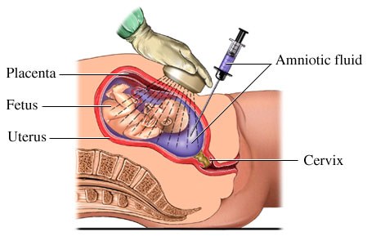
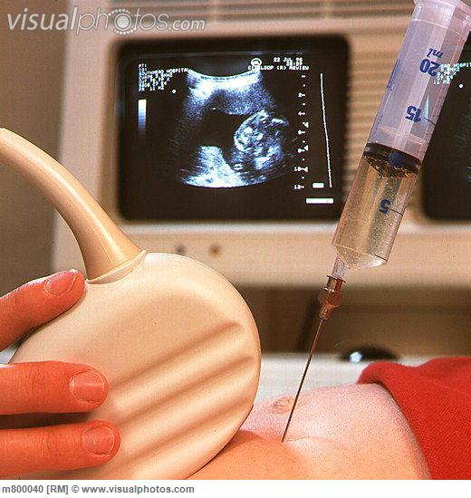
Amniocentesis
Amniocentesis is carried out in the 18th week of pregnancy.
It involves the withdrawal of a little amniotic fluid containing foetal cells.
These cells can be analysed and a full karotype made.
It slightly increases risk of miscarriage

Slide 33
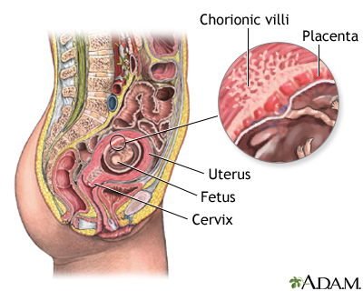
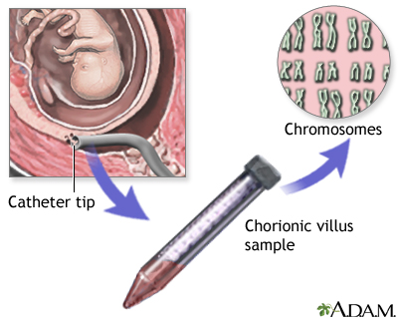
Chorionic Villus Sampling
A small tube is inserted into the womans reproductive tract, placental cells are removed, these cells are used for karyotyping
ADV: CVS can be carried out at 8 weeks of pregnancy
DISADV: Causes a higher risk of miscarriage then amniocentesis

Slide 34
Post-natal Screening
At present none of the inherited disorders can be successfully treated except for PKU
Phenylketonuria results from an inborn error of metabolism for 1:10000 b irths in Britain.
If not detected soon after birth the baby suffers from mental retardation
All British babies are routinely tested for excess phenylalanine after birth by means of a blood test

Slide 35
The End
Notes:
This concludes the STEPPs presentation on developmental screening and referral.
[If time permits, presenter or ICAAP staff should review materials provided in STEPPs resource kit.]
As a reminder, through the duration of the STEPPs project, the Illinois Chapter of the AAP will be happy to provide you with technical assistance and answers to specific questions. We also hope to provide you with updated information through regular mailings or emails to help you implement your developmental screening program.
Finally, please don’t forget to complete your evaluation forms and return them to me or the Chapter staff. Remember, nurses must use the “Educational Design I Evaluation Form” to receive contact hour credit, and all other attendees can use the “Course Evaluation Form” developed by the Chapter.

